Slide 1

Enhancing Exoplanet Discovery with PCA and NMF in Astronomical Imaging
Exploring Linear Algebra and Vector Spaces Applications in Astronomy
Members:
Bhavana-BL.SC.P2CSE25027
Nandana-BL.SC.P2CSE25012

Slide 2
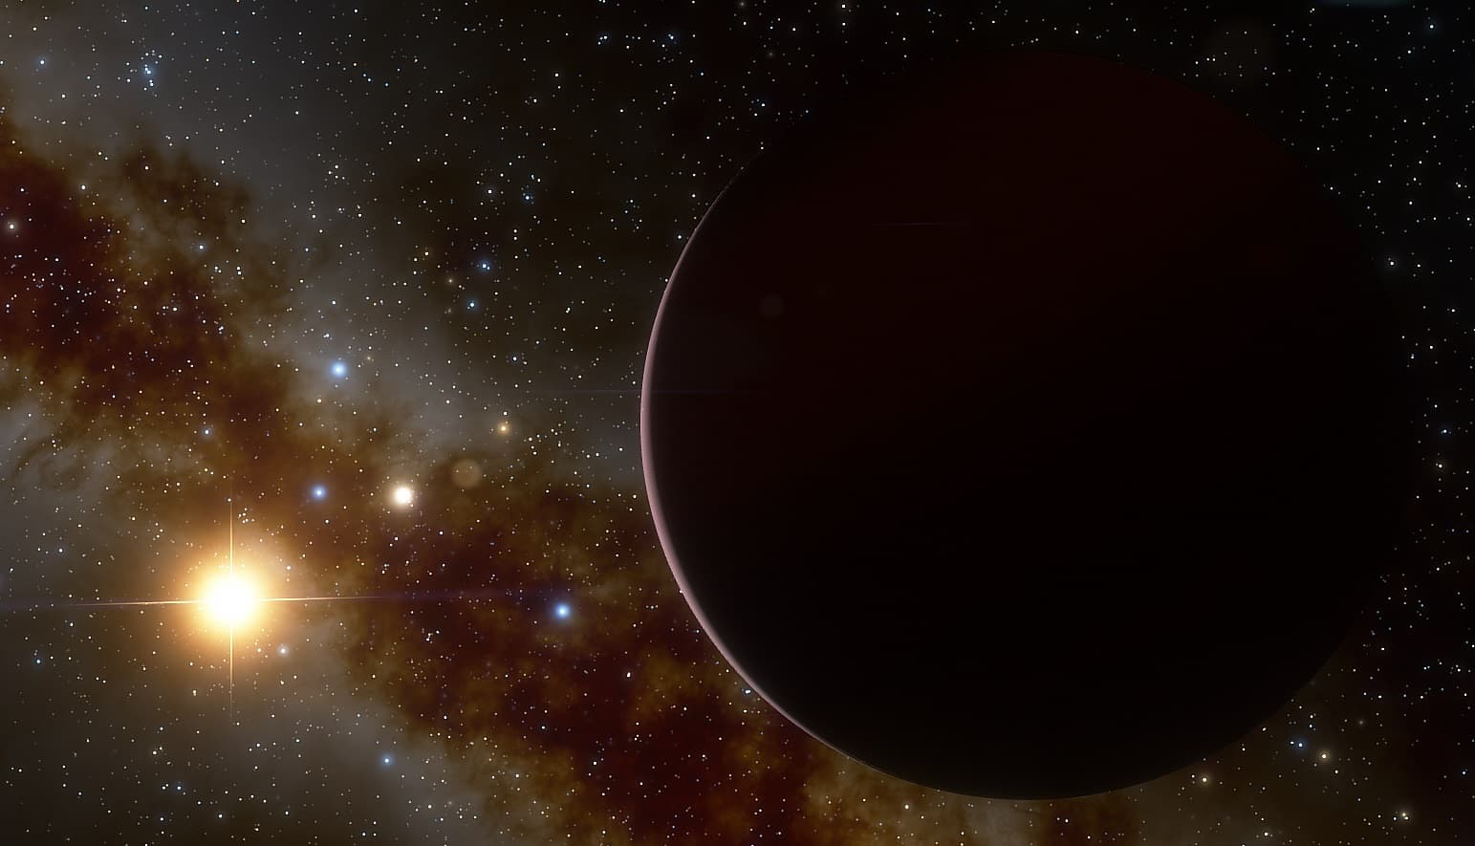
INTRODUCTION
What are Exoplanets?
Planets orbiting stars beyond our Solar System.
Extremely faint: up to 10⁶–10¹⁰ times dimmer than their parent stars.
Direct imaging is difficult because starlight overwhelms the faint planet signal.
Problem in Exoplanet Imaging
Stellar PSF glare dominates the image.
Speckle noise mimics fake planets.
Atmospheric distortions further obscure the signal.

Slide 3
PROBLEM STATEMENT
Exoplanet detection is one of the most challenging tasks in modern astronomy.
The faint light of exoplanets is often billions of times dimmer than their host stars.
Astronomical images captured by telescopes are dominated by stellar glare and speckle noise, which hide the planet’s signal.
Traditional image processing methods fail to effectively separate the planet’s faint light from the bright stellar background.
There is a need for advanced mathematical techniques to enhance the visibility of exoplanets in high-contrast images.

Slide 4
OBJECTIVE
To enhance exoplanet detectability by removing stellar glare and suppressing speckle noise from high-contrast imaging data.
To implement and evaluate PCA and NMF algorithms for efficient PSF subtraction and speckle suppression.
To improve the signal-to-noise ratio (SNR) of faint planetary companions across different angular separations.
To generate accurate contrast and sensitivity curves for assessing detection limits at various separations.
To build a complete reproducible pipeline for exoplanet detection using public astronomical datasets (e.g., VLT/NACO, SPHERE).
To compare PCA vs. NMF performance in terms of SNR, flux retention, speckle suppression, and detection confidence, identifying the best conditions for each method.

Slide 5
LITERATURE Survey
S. No. | Title | Objectives | Techniques | Results | Conclusion
1 | Exoplanet Imaging via Differentiable Rendering, IEEE Transactions on Computational Imaging, 2025 | Integrate physics-informed differentiable rendering to model wavefront propagation and speckle fields, complementing PCA/KLIP post-processing for improved subtraction and detection sensitivity | Differentiable rendering, inverse graphics optimization; framed as a model-based alternative/ augment to PCA/NMF pipelines. | Improved localization and detection under quasi-static speckles versus purely statistical subtraction, with quantitative gains in reported benchmarks. | Physics-based inverse modeling reduces self-subtraction bias and pairs effectively with PCA/NMF for robust exoplanet detection..
2 | Enhanced Classification of Exoplanets Using Machine Learning: Integrating Feature Selection, Ensemble Algorithms, and Explainable AI Insights, 2024 15th ICCCNT (IEEE) | Improve exoplanet class discrimination in KOI using feature selection, ensembles, PCA visualization, and XAI to interpret model decisions; complements imaging pipelines by refining candidate vetting. | KNN, SVM, RF, NB, DT, CNN; ensembles XGBoost, GBM, CatBoost, AdaBoost; data imputation with KNN; outlier handling; KMeansSMOTE for imbalance. | Random Forest best performer with F-measure 0.95; PCA aids structure insight; SHAP identifies key predictors for class decisions. | Feature selection plus ensembles and XAI yields accurate and interpretable exoplanet classification, strengthening end-to-end detection pipelines beyond imaging alone.

Slide 6
LITERATURE Survey
S. No. | Title | Objectives | Techniques | Results | Conclusion
3 | Exoplanet detection in angular differential imaging by learning across multiple observations, MNRAS, 2024 | Learn nuisance speckle statistics to improve detection maps versus cADI/KLIP, mitigating self-subtraction and boosting SNR in ADI/ASDI regimes | Data-driven statistical learning for speckles; comparison to cADI and KLIP; supports multi-spectral fusion (ASDI). | Higher AUC and improved detection maps near the star than KLIP, reducing false positives and self-subtraction | Learning-based speckle modeling outperforms PCA-only baselines, especially with spectral diversity.
4 | Exoplanet detection techniques for direct imaging dark zone maintenance datasets, JATIS 10(4):049003, 2024 | Define detection evaluation protocols in coronagraphic dark-zone maintenance contexts for HWO-like contrasts; position PCA/KLIP within testbed workflows. | Comparative detection frameworks integrating control telemetry with post-processing; PCA/KLIP as baselines | Outlines metrics and procedures to assess detectors at extreme contrasts, informing PCA/KLIP parameterization and limits. | Effective detection at 10^-9–10^-10 requires coupling control data with advanced post-processing beyond PCA alone

Slide 7
What Past Studies Missed vs What We Do ?
Aspect | Past Research (Drawbacks) | Our Project (New Approach)
Method Type | Mostly deep-learning or physics-based rendering models — computationally heavy and complex to train | Pure mathematical decomposition (PCA + NMF) — lightweight, interpretable, and directly applicable
Data Requirements | Needs large labeled datasets or instrument-specific calibration | Works directly on raw telescope image cubes; no labels or training required
Interpretability | Black-box or semi-transparent; difficult to explain decisions | Fully transparent linear-algebra steps; SNR, contrast, and residual maps explainable
Computation Cost | High GPU usage; long training and simulation times | Efficient CPU-only execution; suitable for laptops and research labs
Scope of Analysis | Typically focuses on a single method (e.g., just PCA or just ML) | Performs a combined and comparative study of PCA + NMF, identifying strengths of each
Objective Focus | Emphasis on classification, parameter estimation, or synthetic simulation | Direct improvement of image quality, speckle suppression, and exoplanet visibility
Generalizability | Often instrument-dependent (e.g., requires specific AO or coronagraph models) | Applicable to any high-contrast imaging dataset (ADI/RDI), making it widely reusable

Slide 8
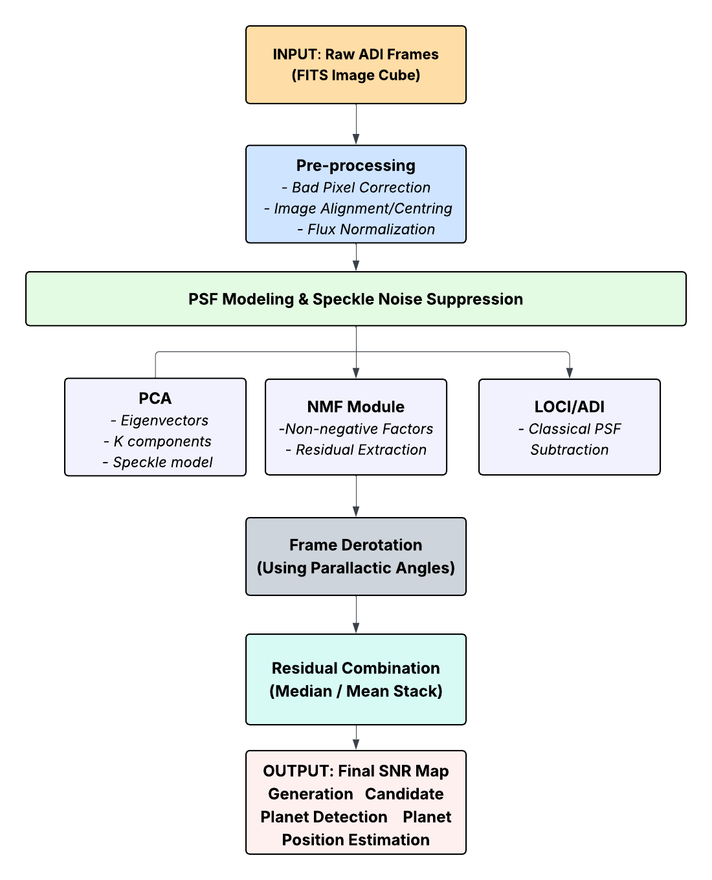
System Overview

Slide 9

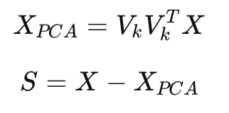
Mathematical Model
The observed astronomical image can be represented as:
where
I: observed image,
P: starlight (PSF),
S: exoplanet signal,
N: noise.
1. PCA (Principal Component Analysis)
Removes dominant starlight patterns (high variance):

Slide 10

Mathematical Model
2. NMF (Non-negative Matrix Factorization)
Decomposes image into additive, non-negative parts:
PCA + NMF together isolate the faint exoplanet light hidden within overwhelming starlight, enhancing detection accuracy.

Slide 11
Methodology
1. Data Acquisition
Import raw ADI FITS image cubes.
Load corresponding parallactic angle sequence.
2. Pre-Processing
Correct bad pixels and detector artifacts.
Align and recenter all frames.
Normalize flux and remove outliers.
3. PSF Modeling & Speckle Reduction
Model stellar PSF and quasi-static speckles.
Apply two mathematical decomposition methods:
  PCA (SVD/KLIP)
  NMF (non-negative factorization)
4. PCA Pipeline
Flatten cube → compute eigenbasis using SVD.
Select optimal number of PCs (12–18).
Reconstruct & subtract PSF → PCA residual cube.

Slide 12
Methodology
5. NMF Pipeline
Decompose cube into non-negative components.
Preserve compact planet-like signals.
Subtract reconstructed speckle model → NMF residual cube.
6. Frame Derotation & Stacking
Derotate residual frames using parallactic angles.
Combine via median/mean stacking to enhance true planetary signal.
7. Detection Metrics
Generate SNR maps to identify significant peaks.
Compute 5σ contrast curves to measure sensitivity vs separation.
8. Comparative Evaluation
PCA → strong speckle suppression at wide separations.
NMF → higher flux retention near star, reduced self-subtraction.
Hybrid interpretation improves confidence of exoplanet detection.

Slide 13
DATA SET
1. Source & Format
The project uses publicly available FITS image cubes included within the VIP High-Contrast Imaging (HCI) library, derived from real telescopes such as VLT/NACO and SPHERE.
2. Dataset Contents
Each cube contains a sequence of raw ADI frames, parallactic angles, and bad-pixel masks—representing real stellar PSF structures, speckle noise, and faint companion signals.
3. Files Used in This Study
Two benchmark datasets are used:
naco_betapic.fits
SPHERE_satspots_centered.fits
These are standard test datasets widely used in HCI algorithm evaluation.
4. Suitability for PCA & NMF
The dataset is compact, well-calibrated, and ideal for testing post-processing techniques (PCA/NMF), enabling reproducible experiments in speckle suppression, SNR enhancement, and exoplanet detection.

Slide 14
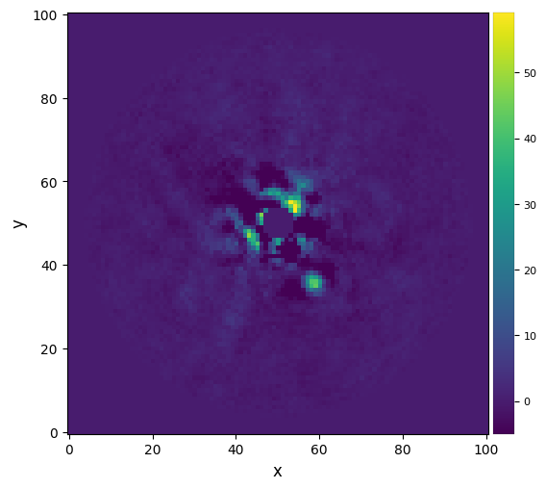
RESULTS
1. Raw ADI Observation
Raw frame captured using Angular Differential Imaging (ADI)
Stellar PSF is extremely bright → planet signal is buried
Speckle noise dominates the inner region
No preprocessing applied yet

Slide 15
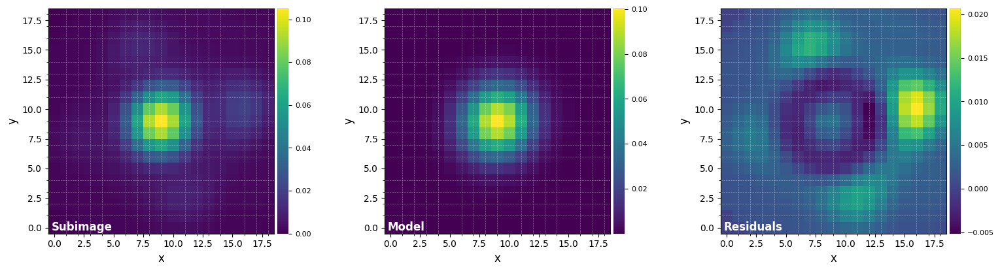
RESULTS
2. Preprocessing Output – Noise, Alignment & Bad Pixel Correction
Bad pixels corrected via median + FFT interpolation
Frames centered using 2D Gaussian fitting
Normalization reduces brightness variance
Preprocessing improves algorithm stability

Slide 16
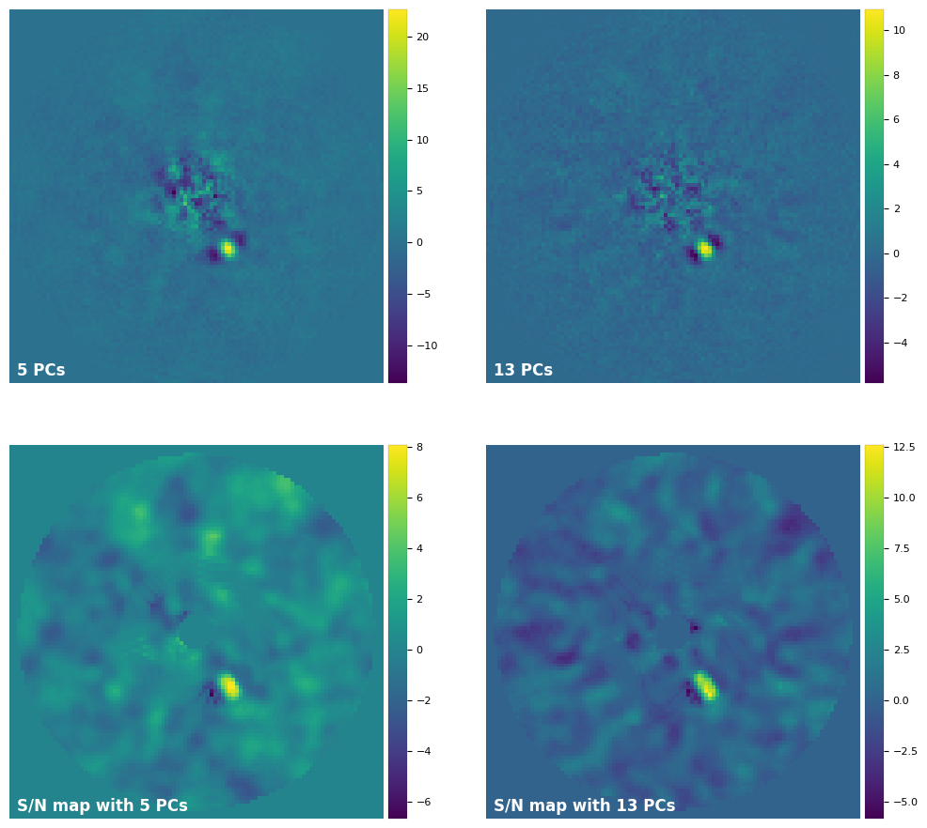
RESULTS
3. PCA-Based PSF Subtraction (Residual Image)
PCA removes dominant PSF components
Speckle noise strongly reduced
Planet-like signal begins to appear
Using 10–20 principal components (optimal)

Slide 17
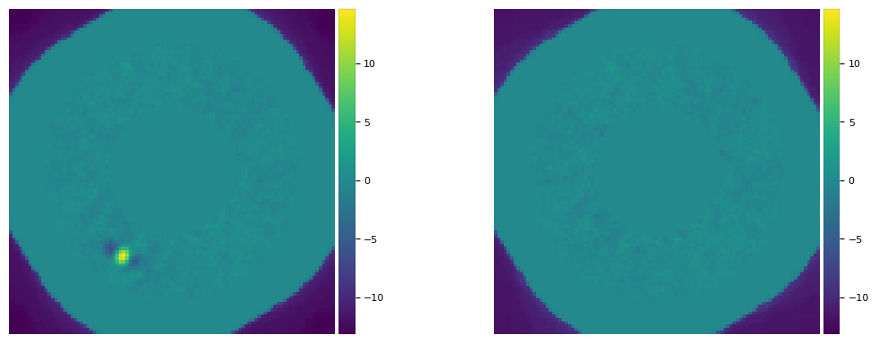
RESULTS
4. NMF-Based Speckle Suppression (Residual Image)
NMF preserves flux better than PCA
No negative components → fewer artifacts
Sharp residual structures
Suitable for small angular separation planets

Slide 18
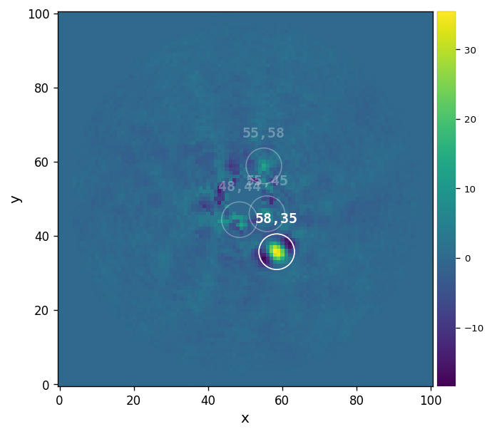
RESULTS
5. Signal-to-Noise Ratio Map After PSF Subtraction
Computes local noise in annular regions
Highlights statistically significant detections
A clear SNR peak (>8) indicates likely exoplanet
Secondary peaks are residual speckles

Slide 19
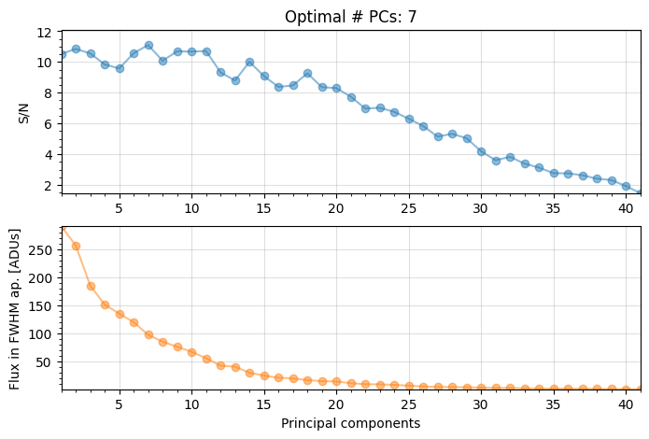
RESULTS
6. PCA Stability: SNR vs Number of Principal Components
SNR increases until ~16 PCs, then decreases
Too few PCs → speckle remains
Too many PCs → real planet is subtracted
Optimal range: 12–18 PCs

Slide 20
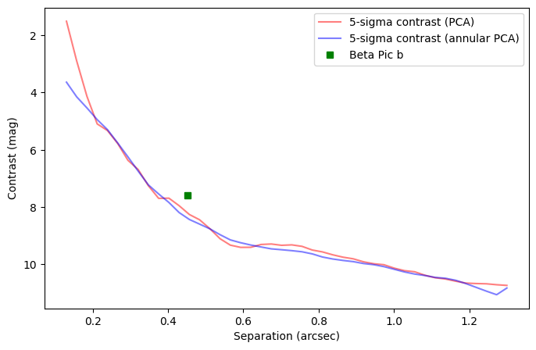
RESULTS
7. Detection Sensitivity Using 5σ Contrast Curves
Contrast improves rapidly with angular separation
Below 0.3 arcsec → dominated by speckles
Beyond 0.8 arcsec → very high sensitivity (~10⁻⁴)
Student-t correction improves accuracy in inner region

Slide 21
RESULTS
8. PCA vs NMF Summary
PCA: Best speckle suppression
NMF: Best flux retention
Together: Complementary strengths
PCA excels at large separations
NMF excels near the star
A real, directly imaged exoplanet orbiting Beta Pictoris
Used as a benchmark target in high-contrast imaging
Appears at ~0.4 arcsec separation
Shown on contrast curves to validate algorithm performance

Slide 22
CONCLUSION
PCA and NMF significantly enhance exoplanet visibility by reducing stellar PSF noise.
PCA provides superior speckle suppression, especially at larger angular separations.
NMF preserves planet flux more effectively, making it ideal near the star.
Selecting optimal PCA components is crucial to prevent self-subtraction of real signals.
5σ contrast curves confirm strong detection sensitivity across multiple separations.
A combined PCA–NMF framework delivers a robust, efficient pipeline for exoplanet detection.

Slide 23
REFERENCES
Feng, B. Y., Ferrer‑Chávez, R., Levis, A., Wang, J. J., Bouman, K. L., Freeman, W. T. “Exoplanet Imaging via Differentiable Rendering.” IEEE Transactions on Computational Imaging, 11, 2025. DOI: 10.1109/TCI.2025.3525971.
Bodrito, T., Flasseur, O., Mairal, J., Ponce, J., Langlois, M., Lagrange, A.‑M. “MODEL&CO: exoplanet detection in angular differential imaging by learning across multiple observations.” MNRAS 534, 1569–1596, 2024.
Ishvarya G., Kammari, K. S., Thambi, S. V., Venugopalan, M. “Enhanced Classification of Exoplanets Using Machine Learning: Integrating Feature Selection, Ensemble Algorithms, and Explainable AI Insights.” 15th IEEE ICCCNT, 2024.
Prasad, M. S., Verma, S., Shichkina, Y. A. “Astronomical Image Processing: Exoplanet Detection.” 2023 XXVI IEEE SCM, DOI: 10.1109/SCM58628.2023.10159069.

Slide 24
Thank you

